Slide 1

How your hobby can help advance your profession

Slide 2
Who am I?
Sorta need to understand me and how I was inspired to write this talk.
Notes:
Include pictures of the Blu-clear briefcase
Mr. Big Head
Screen Shot of Stream
The jacket is for creativity.
Most of the time I make this part small, as I am not the focus. Need you to know more about me, so you know where I am coming from.
More then a loud jacket and a funny set of glasses.
Magic
Saxophone
Destination imagination
Career Day

Slide 3

How does underwater basket weaving help my profession…..
How long can you hold your breath?
How much and what kind of planning might you need to do?
Do you even need a pool?
What materials are going to be needed?
What is the basket going to look like?
Notes:
I know you are her to know the answer to this
Ask any one have an idea or two before I throw out my take?
My takes
Planning
Makes you have faster to dev cycles
Unless you plan on using an alternate air supply
Do you even need to be underwater?
Definitely a plan is needed and logistics worked out.
How many skills are you gonna need to learn to make this happen?
Are you gonna need help?

Slide 4

Expand your network
How many people to you interact with outside of work?
How do you meet new people?
What is unique about yourself?
Notes:
We are more than our jobs.
Depending on the profession and the area that you live in, it can be a really small world.
Ever feel trapped, like in a bubble?
You hobby could be the pin to pop that bubble.
How many people do you know that do the same hobby you do?
Pretty sure there is a group of people wherever you are that have regular get togethers. Go hang out with them….
What you mean you don’t have “time”. -> tell the priority story.

Slide 5

Relieve some stress
Exercise
Gardening
Golfing
Puzzles
Go for a walk
Notes:
All of these help you get out of your mind for a bit.
Think about golfing. Tell the golf story
Think about puzzle building and tell the story about the Improving breakroom
Lowers blood pressure
Give you a moment to “Find yourself”

Slide 6

Creativity
Notes:
No one is telling you what you “have” to-do.
That can be both stifling and liberating at the same time.
Let’s you explore possibilities of what you might want to do
Maybe even lead to a HOBBY!

Slide 7

Better job satisfaction
There will be bad days
Things will happen that are beyond you control
There is light at the end of that tunnel.

Slide 8

Generally Happier
Meeting people with the same interest
Centering yourself
Letting the complication of life drift away
Notes:
Association of Enjoyable Leisure Activities With Psychological and Physical Well-Being - PMC (nih.gov)
PEAT = Pittsburgh Enjoyable Activities Index;
BMI, Waist Circumfrence, Systolic/Diastolic blood pressure

Slide 9

RDD – Resume Driven Design
Notes:
New term I heard the other day “Career Cushioning”
Tell the docker story
No one will pay for you to learn more than the basics
Show a perspective employer that you have a passion for something a drive. Not just doing what you are told to do.
Will help your self-reliance!

Slide 10

Nothing is on fire…. So you can go deep and enjoy the journey

Slide 11

Notes:
One of my favorite songs.
First part….
Perfectly fine: Good enough is good enough
Meets the requirements
Which is how I currently play this song…
Second part…
Provides more value
Over delivers, ie. Build trust
The wife was reminding me where the bedroom was…. ;)

Slide 12
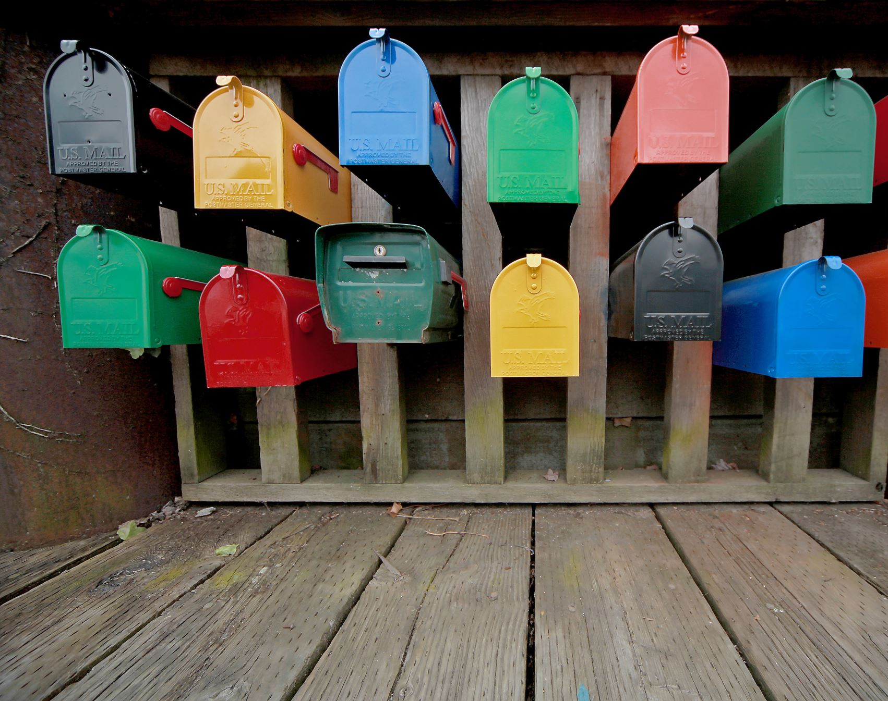
Mailbox Money
Notes:
Joe Brinkman: wood working business with wife.
My twitch stream. Not really a ton of money, but there are some offsets.

Slide 13
How to choose?
Must be enjoyable
Doesn’t matter if you are “good” at it
Maybe your hobby chooses you

Slide 14

Make it a habit
Schedule some time…. With others…
Show off a bit….
So you miss it when you don’t do it.

Slide 15
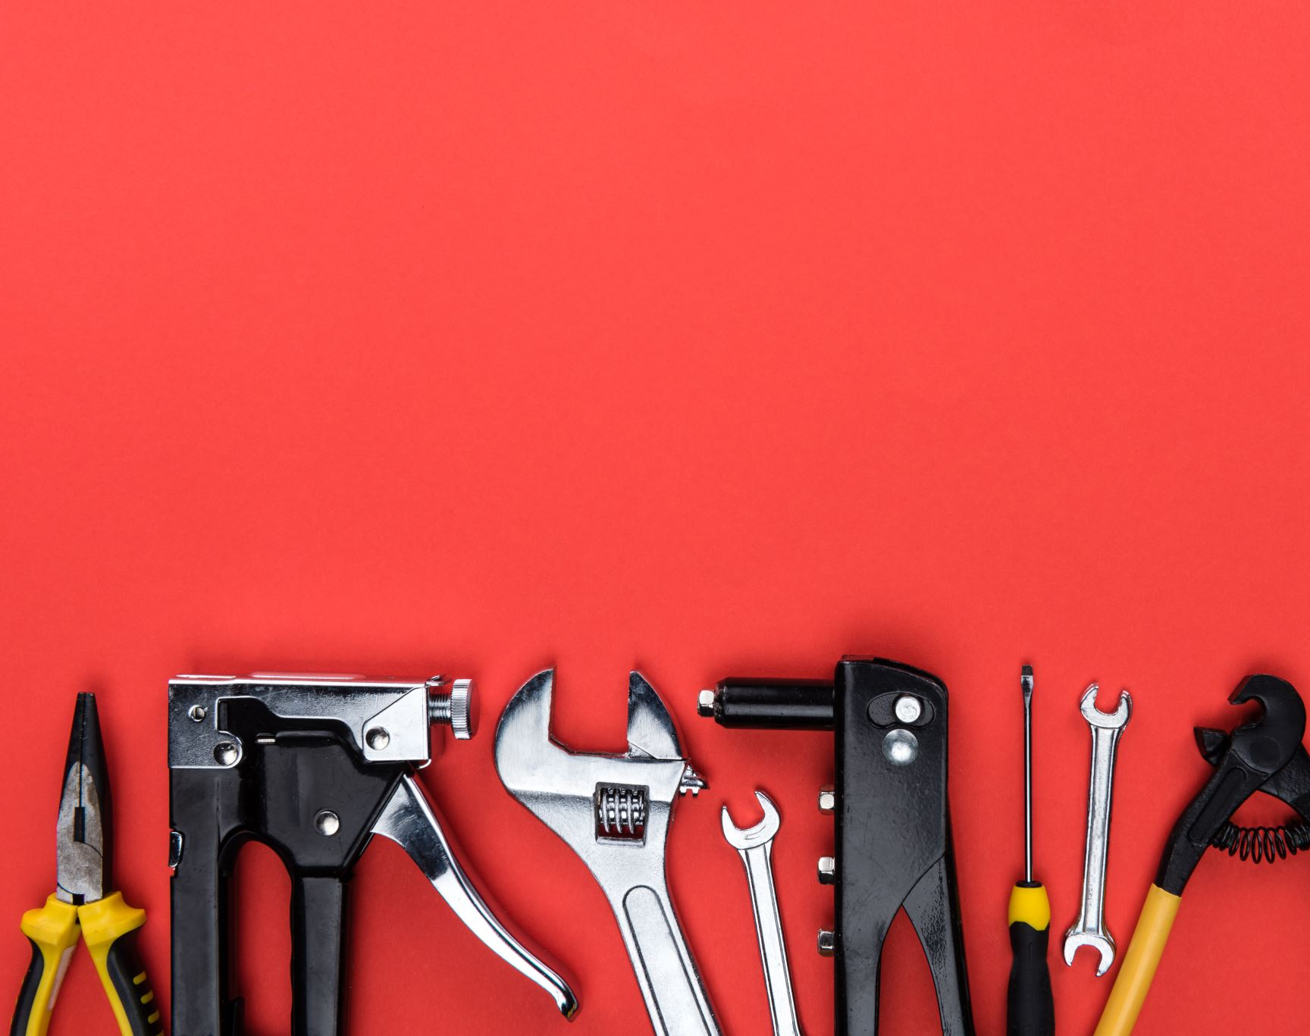
Examples of people and their hobbies
Buffet and his ukileli
Gates reads….. A lot
Mariah Carey collect butterfly stuff
Elon Musk plays First Person Shooters
Barack Obama loves playing pickup basketball games
Mike Tyson breeds racing pigeons
George W. Bush paints
Julia Roberts treasure hunts with metal detectors on the beach
Notes:
Yep, that Warren Buffet… not Jimmy
Gates reads about 50 books a year.
Here are some notable people with unexpected hobbies:
Elon Musk - He is known for his work with Tesla and SpaceX, but he is also a fan of playing video games, especially first-person shooters.
Mariah Carey - The famous singer is a well-known fan of butterfly collecting and has a large collection of butterfly-related items.
Barack Obama - The former President of the United States is an avid basketball player and enjoys playing pickup games when he has time.
Gordon Ramsay - The celebrity chef is known for his love of fast cars and racing. He is a frequent visitor to the racetrack and enjoys driving high-performance sports cars.
Mike Tyson - The former heavyweight champion of the world has a passion for pigeon racing and has been breeding racing pigeons for over 20 years.
Hilary Swank - The two-time Academy Award-winning actress is an avid pilot and holds a private pilot's license.
George W. Bush - The former President of the United States is a talented painter and has been honing his skills since he left office.
Julia Roberts - The famous actress is a fan of using a metal detector to search for treasure and has been spotted using one on the beach during her vacations.
These are just a few examples of famous people with unexpected hobbies. It's always interesting to learn that even the most successful and well-known individuals have passions and interests outside of their public personas.
12 Famous People With The Strangest Hobbies & Obsessions (scoopwhoop.com)

Slide 16
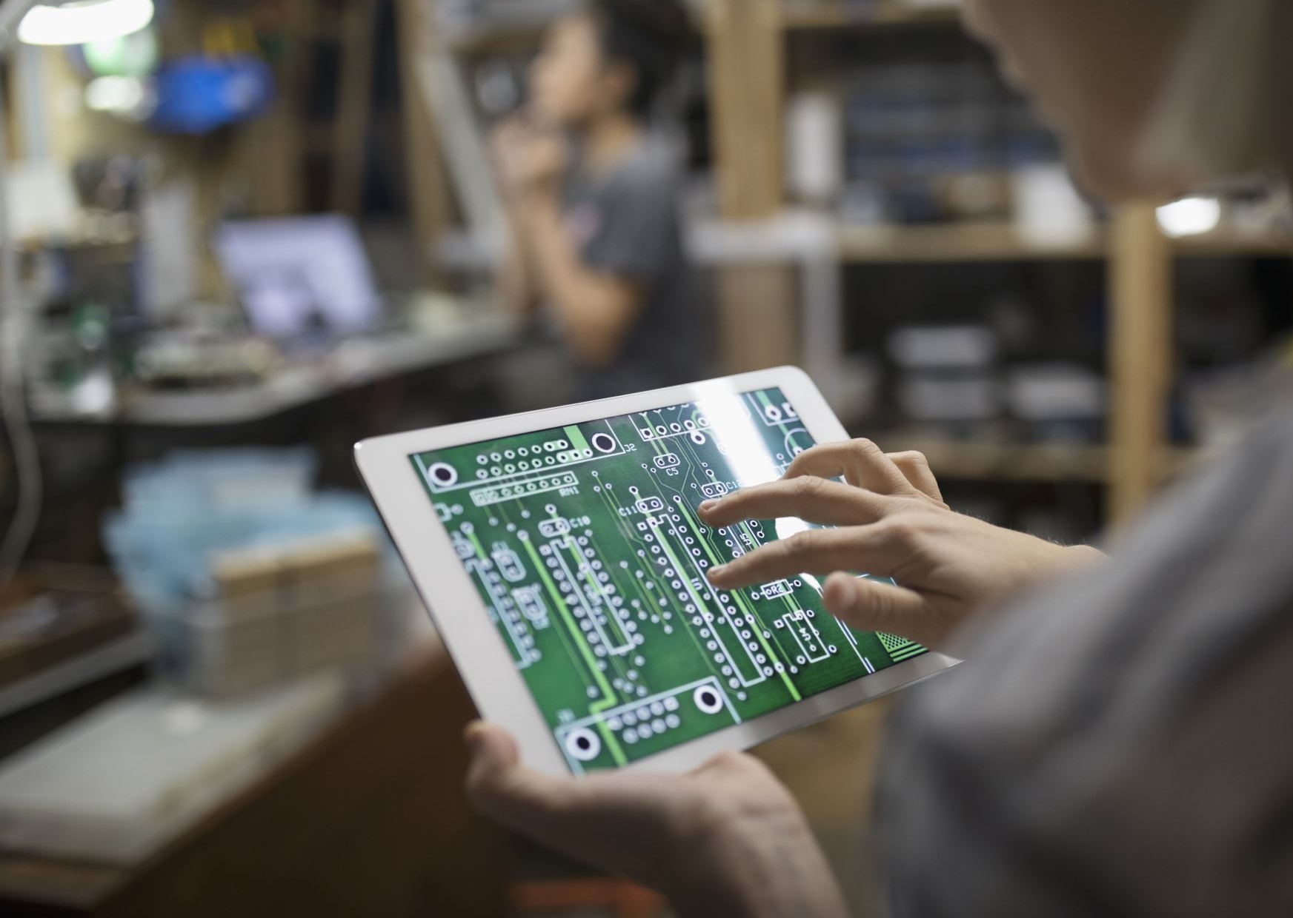
We can do that?

Slide 17
Video Links
EasyMusicLesson: https://youtu.be/yPC3qv8haq4
Jeff Reid and Dave Pollack: https://www.youtube.com/watch?v=D1BNIyoAXs0

Slide 18
Reference links
https://www.blackenterprise.com/5-ways-hobbies-can-help-career/
https://www.smartcompany.com.au/people-human-resources/professional-development/why-having-a-hobby-can-help-your-career/
https://www.marieclaire.co.uk/life/hobbies-helping-career-680098
https://www.ncbi.nlm.nih.gov/pmc/articles/PMC2863117/
https://www.proquest.com/openview/5d9ea365c771fc82adf4e181de38a6ae/1?pq-origsite=gscholar&amp;cbl=1816610
https://www.cnbc.com/2017/08/02/3-science-backed-reasons-having-a-hobby-will-help-your-career.html
http://panorama.ucmerced.edu/news/study-benefits-leisure-go-beyond-moment
https://www.ncbi.nlm.nih.gov/pmc/articles/PMC3962100/
https://www.cnbc.com/2017/03/23/5-habits-that-help-warren-buffett-and-other-leaders-stay-successful.html
https://www.cnbc.com/2016/11/21/4-reasons-why-playing-the-ukulele-like-warren-buffett-could-make-you-more-successful.html
https://www.cnbc.com/2016/11/21/4-reasons-why-playing-the-ukulele-like-warren-buffett-could-make-you-more-successful.html
https://www.entrepreneur.com/article/301015#:~:text=One%20of%20the%20biggest%20benefits%20of%20having%20a,to%20make.%20How%20should%20I%20crop%20that%20shot%3F
https://zenfulspirit.com/2017/05/24/10-ways-to-relieve-stress-that-are-simpler-than-you-thought/

Slide 19
Get in the zone to forget your day-to-day worries.
Bills,
chores,
work,
that creepy person that keeps stealing your lunch…
Watch less TV!

